Slide 1
HMM-based noise-robust feature compensation
Author : Akira Sasou, Kazuyo Tanaka
Professor : 陳嘉平
Reporter : 楊治鏞

Slide 2
Outline
Introduction
Feature compensation based on HMM
Experimental result

Slide 3
Introduction
A distortion of the noisy speech feature in the cepstral domain, which is different from the clean speech feature, can be divided into a stationary distortion component and a non-stationary distortion component.
The proposed method eliminates the degradation of feature-compensation accuracy caused by the non-stationary distortion component.

Slide 4



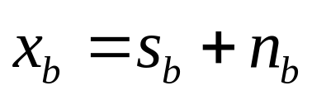

Feature compensation based on HMM
The filter bank energy (FBE) of the noisy speech can be represented as a function of the clean speech and the noise .
Where the subscript denotes that the expression is in the log-FBE domain.

Slide 5

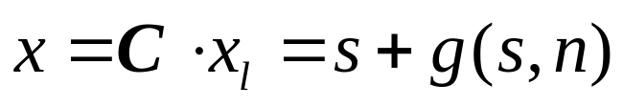



Cepstral domain
The noisy speech in the cepstral domain can be represented by:
Where represents a distortion of the noisy speech in the cepstral domain.
Here and denote the discrete cosine transform (DCT) matrix and its inverse transform matrix.

Slide 6


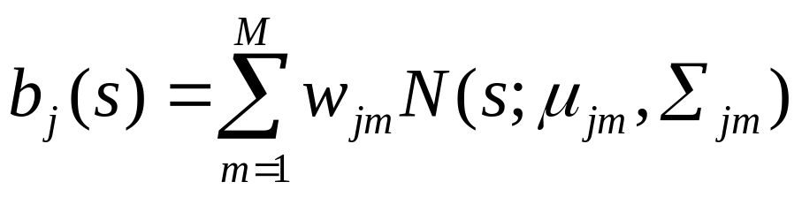


HMM
The output pdf of the th state is given by:
where is the number of Gaussian distributions and is a diagonal matrix.

Slide 7




Element vector
Let denote an element vector consisting of the part of an observed feature vector that is to be compensated.
In our settings, the vector has a 39-dimensional vector, which consists of a 13-dimensional base mel-frequency cepstral coefficient (MFCC) and its delta and delta–delta components, and the element vector corresponds to the base MFCC.

Slide 8
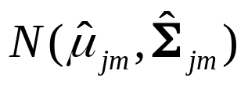

Gaussian distribution
In addition, let represent the Gaussian distribution of the clean speech corresponding to the element vector of the noisy speech.

Slide 9

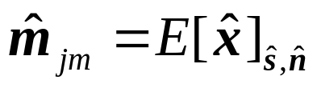
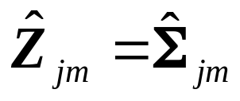




Gaussian distribution
Every noise-adapted Gaussian distribution is then given by:
Where represents the expectation of with regard to both and . The is the noise vector corresponding to the element vector of the noisy speech.

Slide 10
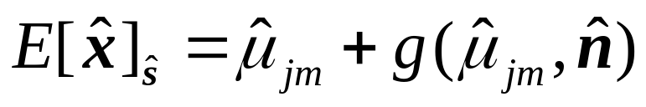



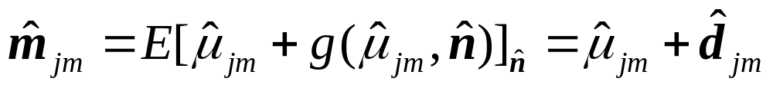
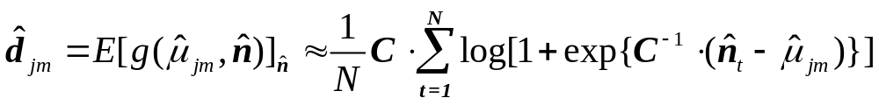

Gaussian distribution
The actual distribution of the noise is not known. Thus, we evaluate the expectation of with regard to as follows:
Where , are noise vectors.

Slide 11



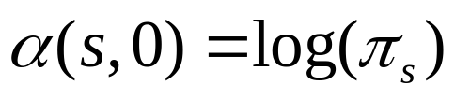

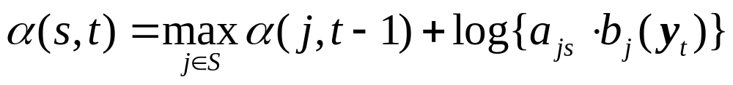




Forward path probability
The proposed method utilizes each forward path probability of the best path to the th state at time for the feature-compensation process.
denotes the entire set of HMM states, denotes the initial probability of the th state, and denotes the transition probability.
where the vector represents the compensated feature vector.

Slide 12

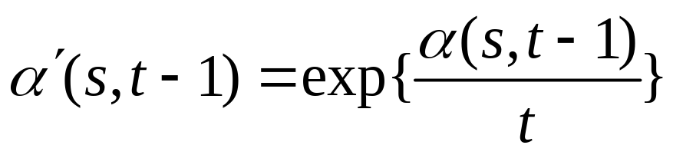
Forward path probability
Using the previously calculated forward path probabilities, we evaluate weights to be applied to the noise-adapted output pdfs of all the states.

Slide 13


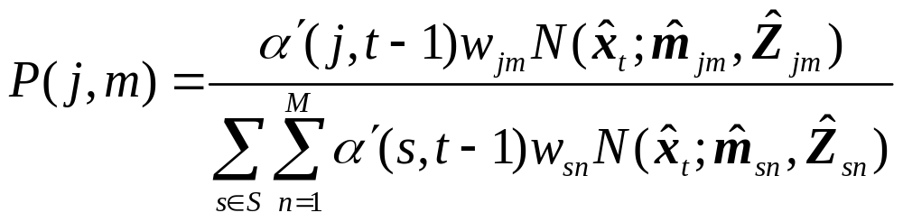

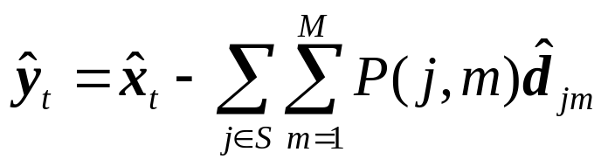
Posterior probability
We adopted the following approximation of posterior probability of each noise-adapted Gaussian distribution :
The compensated element vector is given by:

Slide 14
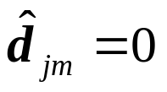
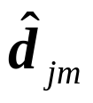
Stationary component
When the noise has no stationary component, such as transient pulse noises, the stationary distortion components are ideally equal to zero:
In this case, we need to find another feature-compensation formula without using .

Slide 15
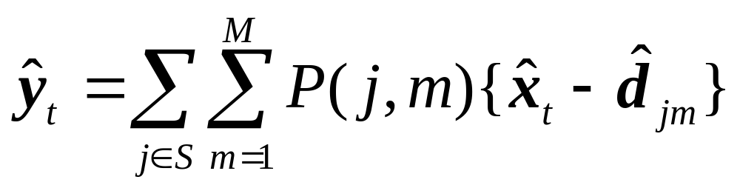



Feature-compensation formula
where can be regarded as an estimate of the clean speech feature assuming that the clean speech feature was emitted from the th Gaussian distribution in the th state’s pdf.

Slide 16
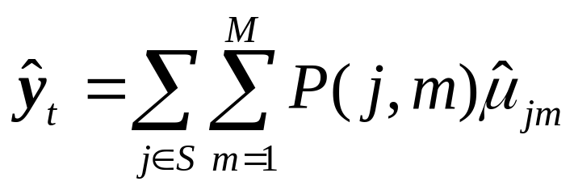



Feature-compensation formula
The expectation vector of the Gaussian distribution can be also regarded as an estimate of the clean speech feature, because the expectation vector is the most probable one in the distribution.
The compensated feature vector is finally obtained by combining the compensated element vector with the elements of the observed feature vector except the element vector .

Slide 17
Experimental set-up
AURORA2
Method 1
Method 2

Slide 18
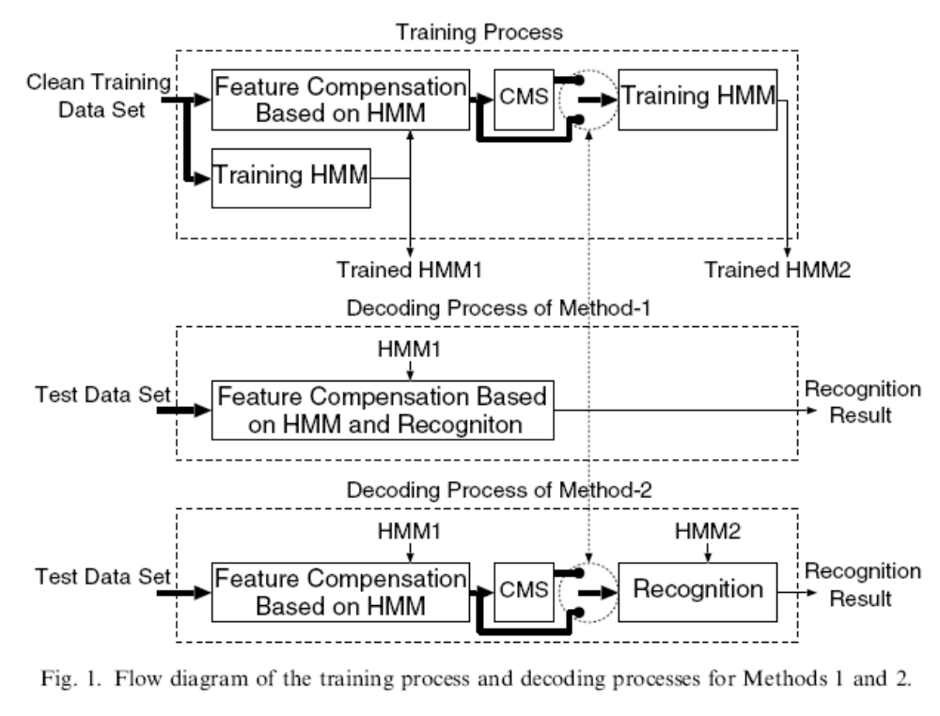

Slide 19
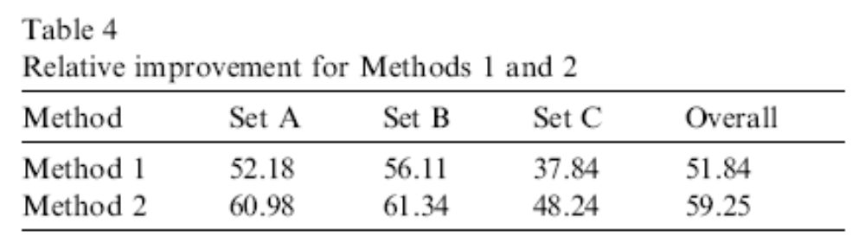

Slide 20
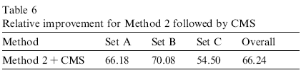

Slide 21
Comparison of GMM-based method
To compare the proposed method with the GMM-based feature-compensation method, we conducted experiments using GMM followed by CMS as front-end feature compensation.
The number of Gaussian distributions ranged from 64 to 4096.
Each back-end HMM was trained from the compensated features for each condition.

Slide 22
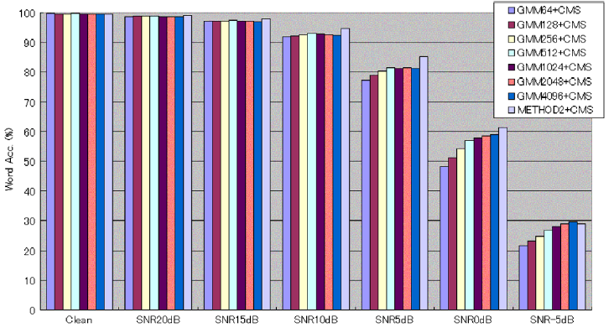

Slide 23
Evaluation in a transient pulse noise environment
In the experiment conducted in a transient pulse noise environment, we used wooden collision sound sources recorded in the Real World Computing Partnership (RWCP) Sound Scene Database.
We generated noise-corrupted speech data by adding a transient pulse every 125 ms to clean speech data from AURORA2.

Slide 24
